Slide 1
SSG E – VOTING SYSTEM USING LARAVEL FRAMEWORK IN BOHOL ISLAND STATE UNIVERSITY – BILAR CAMPUS
Mark Russel Baral
Marry Ann Gallebo
Romeo Luayon

Slide 2
Rationale
The research focuses on improving the election process of the Supreme Student Government (SSG) at Bohol Island State University - Bilar Campus. Due to the COVID-19 pandemic, the traditional face-to-face election method was not feasible, and a web-based e-voting system using the Laravel framework was proposed.

Slide 3
The current use of Google Forms raised concerns about the honesty of the election, as students from other BISU campuses could access the form. The designed e-voting system addresses these issues by providing a secure and accessible platform exclusively for BISU - Bilar students. The Laravel framework ensures protection against common web application security threats, safeguarding the integrity of the voting process and enhancing efficiency by generating reports.

Slide 4
Statement of the Problem
The study aims to assess and develop an SSG E-Voting System using Laravel Framework in Bohol Island State University - Bilar Campus.
Specifically, it sought to answer the following questions:
1. What are the operations and processes of the SSG election in BISU-Bilar Campus?

Slide 5
2. What are the problems and needs encountered in the voting process?
3. What are the ways to improve the current voting platform process?

Slide 6
4. How to design and developed the system with the modules:
a. Login
b. Administration
c. Record Voters
d. Voting
e. Tally
f. Reports
5. What is the level of the system usability as perceived by the target user?

Slide 7
General Objective
The main goal of the study is to design a system that will improve the existing voting platform of BISU Bilar Campus.
Specifically, the project aims the following objectives:
1. To develop a system that will improve the current voting platform.
2. To test and evaluate the usability of the developed system.
3. To implement the developed a web based e-voting system using laravel framework.

Slide 8
Scope and Limitation
This study encompasses only the development and implementation of a ssg e - voting system which secures a reliable election by undergoing a series of process.
1. Acquisition – This module includes the acquiring of data and recording of users, candidates, and votes.
2. Administration – This feature enables the management of users, access, and security while providing administrative tools for system maintenance and configuration.

Slide 9
3. Reports – The system generates reports on the results of the election.
4. Online Mechanism – This module allows the web-based electronic voting system using the Laravel Framework and a modular design that fulfills the system's requirements.

Slide 10
Chapter 2
Needs of the Present System

Slide 11
The needs of the present system serve as the basis for the development of the features of the SSG E-Voting System in BISU Bilar Campus. This study was expected to address the problems encouraged in the present system.
Administration
The SSG Adviser will log in as an admin with unlimited access to the system and also the SSG Staff with limited access to the system. Username and password must be entered values match in the database and the user may now access the system

Slide 12
Recording of Voter’s Profile
Newly registered voters will be added to the system and stored in the voters.tbl. Additionally, their ISMIS ID will be inputted for identification purposes.
Recording of Candidate’s Profile
The candidates, along with their desired position and party list, will be added to the system and stored in the candidates.tbl.

Slide 13
Polling Commencement
After the candidate data has been prepared, the initiation of the election is the duty of the SSG adviser. Access to the system will not be granted to voters until the SSG adviser commences the election. This responsibility of initiating the election solely belongs to the SSG adviser.
Voting Process
Before a voter can cast their vote, they need to be authenticated to ensure that they are eligible to vote. This can be done by requiring them to log in using their unique ISMIS ID. Once the voter is authenticated, the system will display the ballot with the list of candidates and their corresponding positions. The voter can then select their preferred candidate for each position. After the voter has made their selection for each position, the system will record their votes and tally them automatically.

Slide 14
Generation of Reports
The SSG Adviser will use the system to produce the election results showing the list of candidates, their positions, and the vote count.

Slide 15
Use Case Diagram
In software engineering, a use case is a list of actions or event steps typically defining the interactions between a role (known in the Unified Modeling Language as an actor) and a system to achieve a goal. The actor can be human or other external system. The detailed requirements ay then be captued in the Systems Modeling Language (SysML) or as contractual statements.

Slide 16
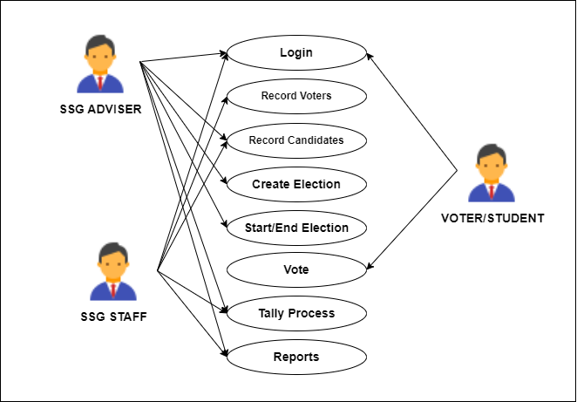

Slide 17
Use Case Narrative
Table 1. Use Case Narrative 1 – Login Account
Login (UC1)
Scope | SSG E – Voting System
Level | User goal
Goal in context | To give access to the system
Primary Actor | SSG Adviser
Stakeholders | SSG Adviser wants to access the system
Preconditions | SSG Adviser will login to the system
Triggers | SSG Adviser decide to login
Success Guarantee | SSG E – Voting System will grant access for the selected user
Scenarios:
SSG Adviser select the function “Login” The system displays the Dashbboard

Slide 18
Use Case Narrative
Table 2. Use Case Narrative 2 – Record Voters
Record Voters (UC2)
Scope | SSG E – Voting System
Level | User goal
Goal in context | To enable the SSG Adviser and SSG Staff to add a voter
Primary Actor | SSG Adviser, SSG Staff, Voter
Stakeholders | The SSG Adviser wants to register the voter so that the voter can vote
Preconditions | The SSG Adviser or the SSG Staff should be able to access the system and have the necessary privileges to add a voter.
Triggers | The SSG Adviser decides to adds a new voter
Success Guarantee | SSG E – Voting System successfully adds the new voter
Scenarios:
SSG Adviser select the function “voter” The system displays the the list of voters

Slide 19
Use Case Narrative
Table 3. Use Case Narrative 3 – Record Candidates
Record Candidates (UC3)
Scope | SSG E – Voting System
Level | User goal
Goal in context | To enable the SSG Adviser and SSG Staff to add a voter
Primary Actor | SSG Adviser, SSG Staff
Stakeholders | The SSG Adviser wants to register the candidates with their desired positions
Preconditions | The SSG Adviser or the SSG Staff should be able to access the system and have the necessary privileges to add a candidate.
Triggers | The SSG Adviser decides to adds a new candidate
Success Guarantee | SSG E – Voting System successfully adds the new candidate
Scenarios:
SSG Adviser select the function “candidate” The system displays the the list of candidates

Slide 20
Use Case Narrative
Table 4. Use Case Narrative 4 – Create Election
Create Election (UC4)
Scope | SSG E – Voting System
Level | User goal
Goal in context | To enable the SSG Adviser to create an Election
Primary Actor | SSG Adviser
Stakeholders | The SSG Adviser wants to create an election
Preconditions | The SSG Adviser should be able to access the system and can create an election
Triggers | The SSG Adviser decides to create an election if the candidates data are ready
Success Guarantee | SSG E – Voting System successfully create an election
Scenarios:
SSG Adviser select the function “create election” The system displays the name of the election that should be modified

Slide 21
Use Case Narrative
Table 5. Use Case Narrative 5 – Start/End Election
Start/End Election (UC5)
Scope | SSG E – Voting System
Level | User goal
Goal in context | To enable the SSG Adviser to start or end an election
Primary Actor | SSG Adviser
Stakeholders | The SSG Adviser wants to start or end the election
Preconditions | The SSG Adviser should be able to access the system and have the necessary privileges to start or end the election.
Triggers | The SSG Adviser decides to start if the candidates' data is ready and end if the election is done
Success Guarantee | SSG E – Voting System successfully start/end the election
Scenarios:
SSG Adviser select the button “start/end election” The system should response after it select the button

Slide 22
Use Case Narrative
Table 6. Use Case Narrative 6 – Vote
Vote (UC6)
Scope | SSG E – Voting System
Level | User goal
Goal in context | To enable voters to vote their desired candidates
Primary Actor | Voter
Stakeholders | The Voter wants to vote their desired candidates
Preconditions | The SSG Adviser or the SSG Staff should be able to access the system and have the necessary privileges to vote.
Triggers | The voters decided to vote and choose their desired candidates
Success Guarantee | SSG E – Voting System successfully recorded the votes
Scenarios:
Voter select the function “Login” The system displays the candidates and their position

Slide 23
Use Case Narrative
Table 7. Use Case Narrative 7 – Reports
Reports (UC7)
Scope | SSG E – Voting System
Level | User goal
Goal in context | To provide an accurate report os the system To generate reports to be view by SSG Adviser and SSG Staff
Primary Actor | SSG Adviser, SSG Staff
Stakeholders | The user wants to have a faster generating of reports The user want to generate accurate reports
Preconditions | The SSG Adviser or the SSG Staff Adviser will view the reports about voter information data
Triggers | The SSG Staff need to view the accurate reports of the election results
Success Guarantee | SSG E – Voting System allows the SSG Adviser and SSG Staff to view the current reports of the voter
Scenarios:
The SSG Adviser and SSG Staff select the function “Report” and view the current report of the voter and election result The system displays the accurate data of the voter and election result

Slide 24
Class Diagram
A class diagram is an illustration of the relationships and source code dependencies among classes of the system, their relationships (including inheritance, aggregation and association), and the operations and attributes of the classes (Margaret, 2007).

Slide 25
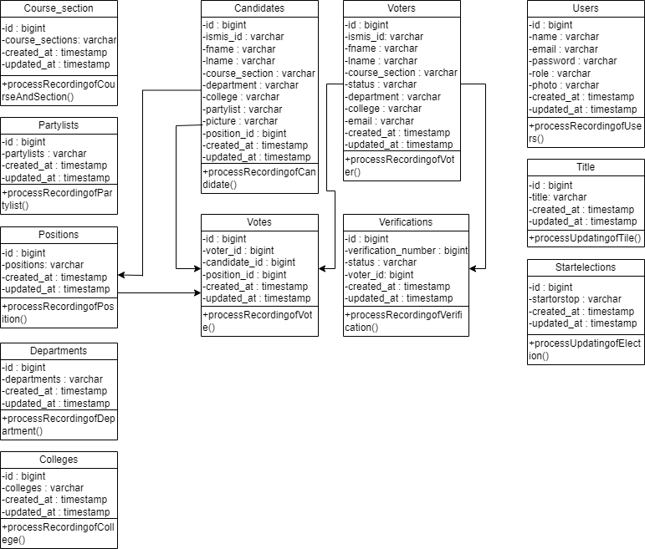

Slide 26
Chapter 3
SUMMARY OF FINDINGS, CONCLUSION, AND RECOMMENDATIONS

Slide 27
Summary of Findings
The current voting process implemented in the BISU Bilar Campus has encountered limitations. The Student Supreme Government (SSG) still uses Google Forms for voting, which is not an optimal solution. Customizing Google Forms takes time, and the security of the system may not be strong enough to ensure the integrity of the votes. This could potentially compromise the fairness and accuracy of the election. The SSG Adviser and SSG Staff have experienced limitations with Google Forms in terms of time and security. To address these issues, researchers have developed the SSG E-Voting System using Laravel Framework, which includes modules for voting, recording voters, and administration.

Slide 28
The developed system fits the need of the unit as revealed in the system usability testing as assessed by the target user using the system usabilty questionnare. Based on the result of the evaluation, the target client had “Agree” on the usefulness presented by the developed system. This implies that the system had met the needs and eliminated the gaps that were identified in the study.

Slide 29
Conclusion
According to findings of the study, the researchers concluded that the SSG E-Voting System developed using Laravel Framework in Bohol Island State University - Bilar Campus has improved the voting process, as well as the security, retrieval, and storage of voters’ personal data.The system evaluation rating with an average mean of 6.04 which was interpreted as ”Agree” as to system usability to the target clients. This indicates that they were satisfied with the functions in terms of usability, visibility, and user experience. Based on the analysis, the respondents believed and were satisfied that the system is functional.

Slide 30
Recommendations
Based on the observations during the implementation and on the aforementioned conclusion, the researchers have suggested the following for smooth system adaptation and operation, as well as for future development:
1. Concerned office conduct benchmarking before the full
implementation of the system;
2. Researchers must conduct system training seminars for the
primary or target users to familiarize themselves and be
oriented with the features and operation of the new system;
3. System maintenance must be done by the programmer on a
regular basis to ensure the protection of records and the
system’s dependability.

